Slide 1

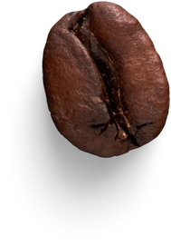


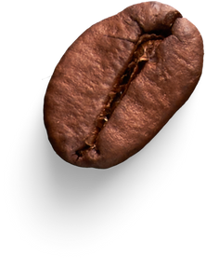
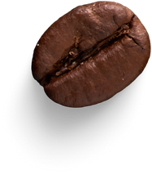
BRIGHT
COFFEE
PRESENTATION
BY VF MULAUDZI

Slide 2
Agenda
Introduction
Closing remarks
Improvement
Key insight & visualization
Recommendations

Slide 3

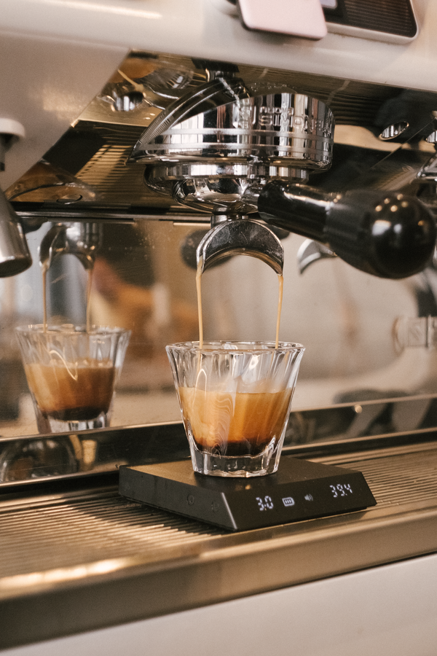


Welcome to our presentation on the sales performance and analysis of Bright Coffee, a specialty coffee retailer dedicated to delivering high-quality beverages and an exceptional customer experience.
In this presentation, we will explore key insights derived from transactional data collected across Bright Coffee’s stores. The objective is to identify patterns, trends, and opportunities that can support strategic decisions in areas such as product performance, sales timing, pricing effectiveness, and customer behavior

Slide 4
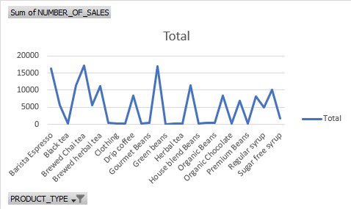
Viewership by Sales by product category

Slide 5
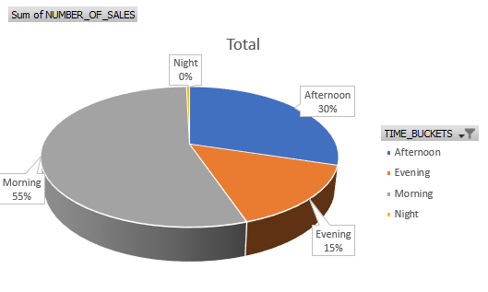


Viewership by Peak time intervals for sales

Slide 6


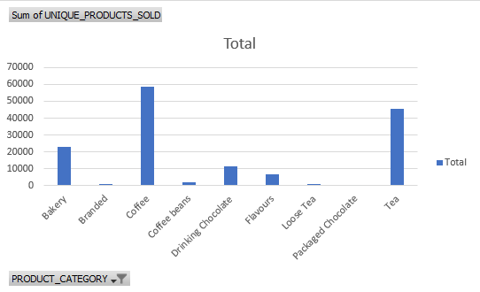
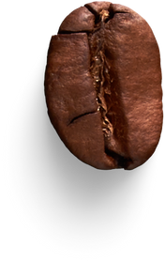
Viewership by Quantity of items sold by product category

Slide 7
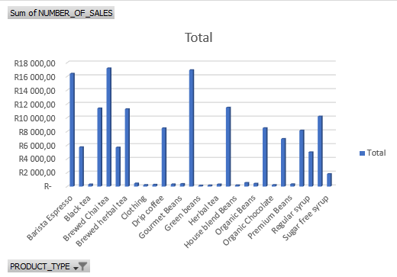
Best-selling product types or details

Slide 8



how to generate more sales
Adjust prices based on demand, seasonality, or competitor trends.
Create urgency to encourage faster purchasing decisions.
Reward repeat customers with exclusive discounts or perks.
Ensure high-demand products are always available.
Run campaigns focusing on high-value customer segments using data insights.

Slide 9
Recommendations
Compare prices with industry benchmarks and adjust accordingly.
Bulk Purchase Discounts: Encourage higher quantity purchases by offering tiered pricing
Offer limited-time discounts to create urgency and attract more buyers.
Pair slow-moving products with best-sellers to increase their visibility.
Provide special incentives for customers purchasing underperforming items.

Slide 10



Thank You

